Slide 1
Power to
Withdraw

Slide 2
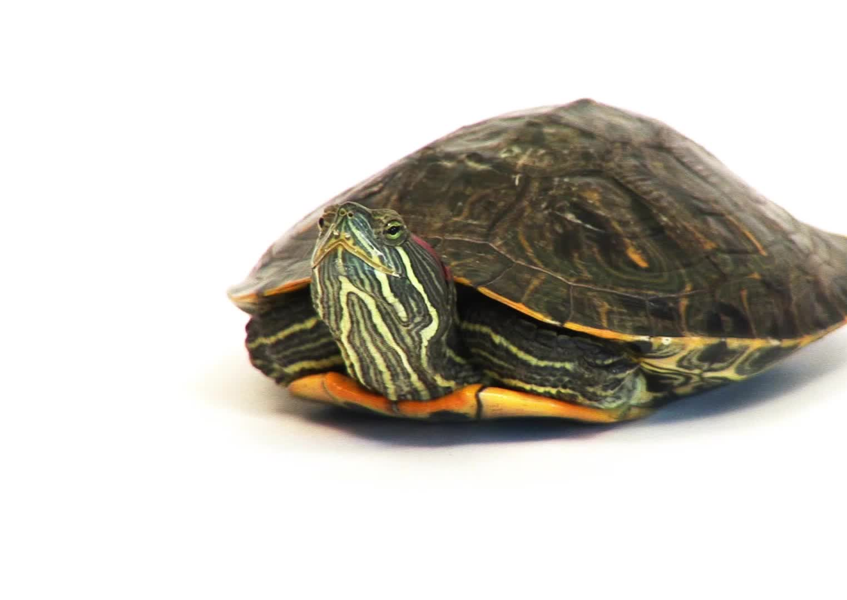
The Power to Withdraw
The ability to go inwards so that you can disengage from the world around you.
To pause, step back from a situation, just like a turtle pulling back into its shell
To access the space inside that is quiet and all yours.

Slide 3
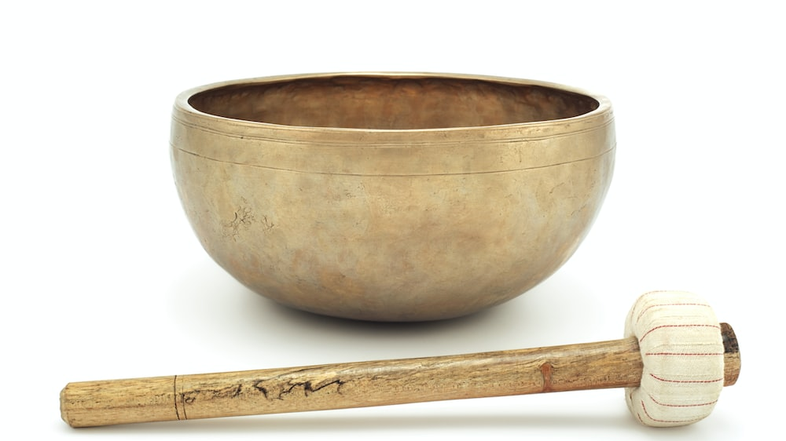

Slide 4
POWER TO WITHDRAW
I am powerful. I return to my “centre” and see what matters right now, then gently send energy forward in time to pave a path to peace.

Slide 5
POWER TO WITHDRAW
I am powerful. Knowing there is a time to be connected to people and places and a time to remove myself physically from them, I respectfully allow space.

Slide 6
POWER TO WITHDRAW
I am powerful. During quiet reflection on my personal values, I get to the heart of the matter and protect myself from irrelevant influence.

Slide 7
POWER TO WITHDRAW
I am powerful. I step back from the situation knowing that I am more powerful after a pause than before one.

Slide 8
POWER TO WITHDRAW
I am powerful. I go into silence,
become clear by detaching myself
from my own expectations or desires in the situation, and listen to what
others are actually saying.

Slide 9
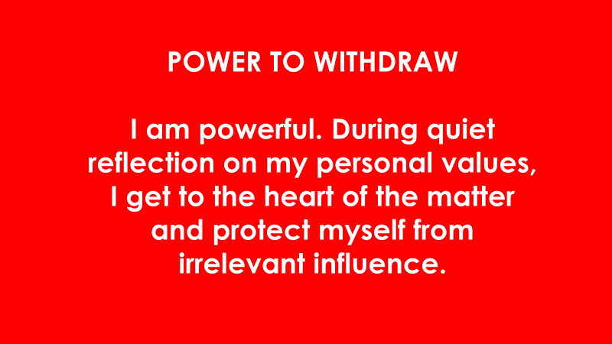
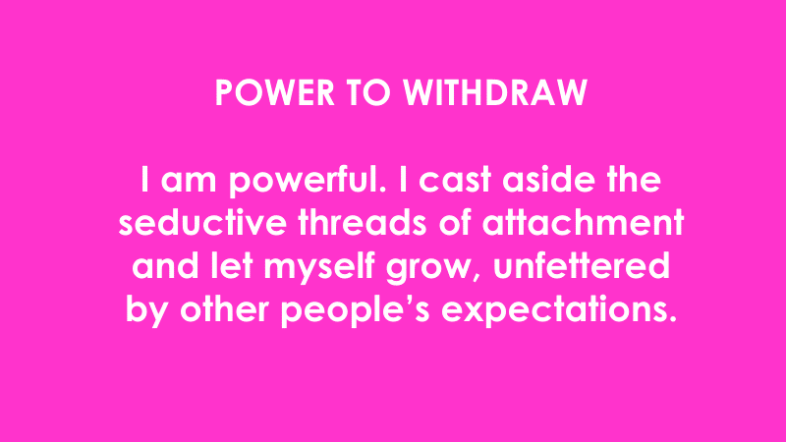

Slide 10
Power to Pack-Up

Slide 11
S.O.S Stop. Observe. Steer.

Slide 12
The Power to Pack-Up
The ability to stop wasteful thinking
The ability to control what you think … rather than have your mind control you.
To let go of old habits … to let go of the dictates of tradition, culture, old fears that we carry around in us and with us.

Slide 13
POWER TO PACK-UP
I am powerful. To make a fresh start, I let go of painful memories and old resentments.
Past is past…

Slide 14
POWER PACK-UP
I am powerful. I release myself from unhelpful beliefs based on the past, and create a fresh
self-image based on actual talents and values.

Slide 15
POWER TO PACK-UP
I am powerful. I remain free from the web of inferior or superior feelings that seek to trap me, I stay unbiased and let ideas flow, free of judgement.

Slide 16
POWER TO PACK-UP
I am powerful. If the past was hard, it does not mean the future has to be. I seek joy, not control, and walk carefree into the future.

Slide 17
POWER TO PACK-UP
I am powerful. I cast aside the seductive threads of attachment and let myself grow, unfettered by other people’s expectations.

Slide 19
Power to Discern

Slide 20
The Power to Discern
The ability to tell whether something is:
Real from Fake
Right from Wrong
Truth from False

Slide 21
The Power to Discern Virtues
Trust
Clarity
Accuracy
Honesty

Slide 22
POWER TO DISCERN
I am powerful. I take quiet
reflection time to concentrate
on my own inner truth, liberating
me from illusion.

Slide 23
POWER TO DISCERN
I am powerful. The
disappointments and joys of my life, now part of my inner map, let me know what is destructive and in each situation what is helpful.

Slide 24
POWER TO DISCERN
I am powerful. I create a daily discipline of reflection. This helps me see more clearly, distinguishing fact from fiction,
natural from synthetic and necessary from irrelevant.

Slide 25
POWER TO DISCERN
I am powerful. I accept the responsibility that goes hand in hand with the right to choose and ask “what is best for everyone?”

Slide 26
POWER TO DISCERN
I am powerful. Concentration on inner truth liberates me from all forms of greed, which can spin me into illusion.

Slide 28
The Power to Decide
The ability to assess the quality of choices, decisions and actions in yourself and others.
Assess situations quickly so you can see the correct response and the action that you need to take.

Slide 29
The Power to Decide Virtues
Faith
Balance
Wisdom
Commitment

Slide 30
POWER TO DECIDE
I am powerful. I strengthen my decision-making ability every day, knowing that each small decision prepares me for making the big decisions that have far reaching implications.

Slide 31
POWER TO DECIDE
I am powerful. Knowing that
each action bears its own fruit, I
remain attentive on the quality
of thoughts, words and actions.

Slide 32
POWER TO DECIDE
I am powerful. By committing to
my choices I earn respect and
attract full support – sometimes
from unexpected sources.

Slide 33
POWER TO DECIDE
I am powerful. I keep everyone’s
well-being in mind and use my own observations rather than second-hand reports to choose a course of action.

Slide 34
POWER TO DECIDE
I am powerful. I trust time and
wait, never pushed to make
important decisions. I trust that
I know what to do.

Slide 35
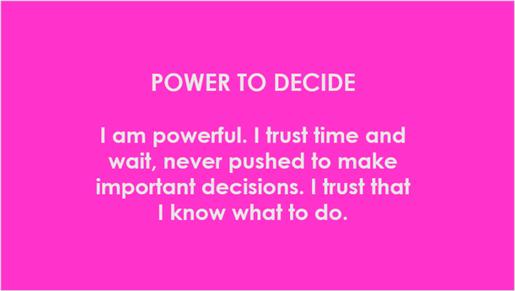

Slide 36
Power to Tolerate

Slide 37
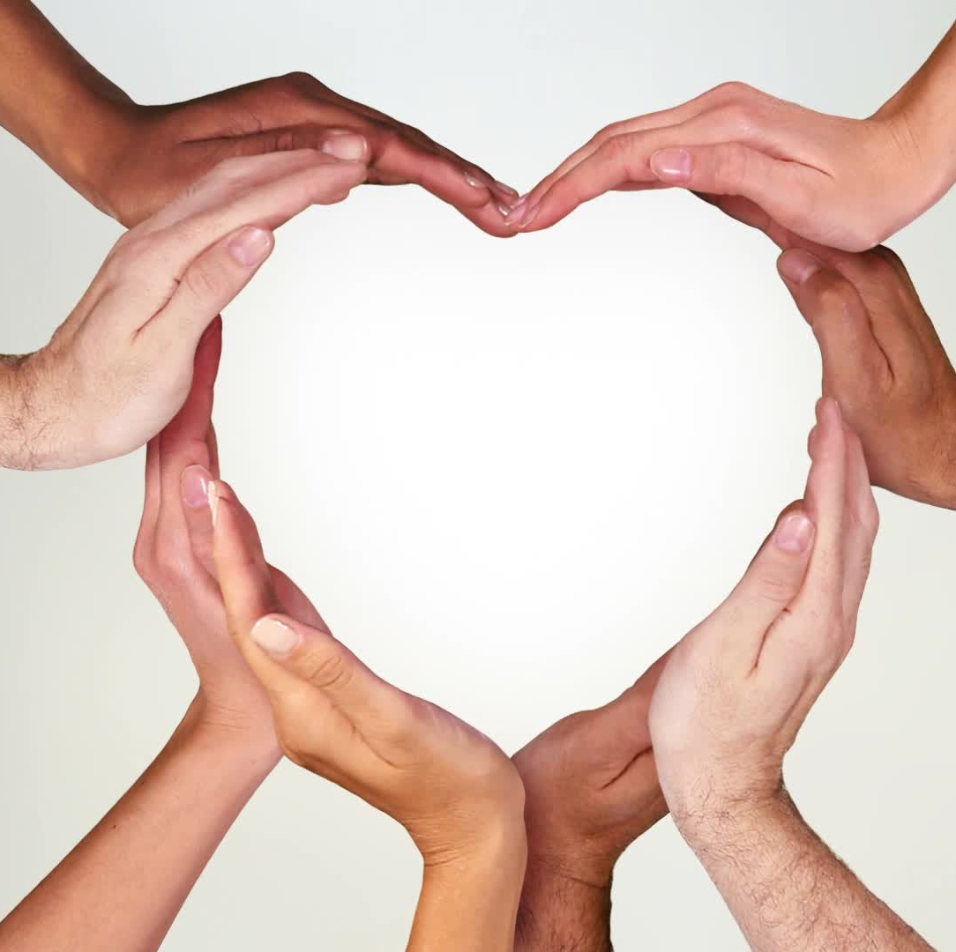
The Power to Tolerate
The capacity to accept external situations that are not ideal
The power of love
Like a mother

Slide 38
H
E
A
R
T
E
X
P
A
N
S
I
O
N

Slide 39
H
E
A
R
T
Recognized I am a soul
Learned about & connected with God
E
X
P
A
N
S
I
O
N
Son Born
Helplessness
Volunteer at National Wheelchair Games
Dedication, strength & hard work
New Respect
Selfless Love
Love for
Humanity

Slide 40
POWER TO TOLERATE
I am powerful. My capacity to stretch my boundaries and soften all edges in relationships takes the pressure off
and lets everyone grow.

Slide 41
POWER TO TOLERATE
I am powerful. I do not take to heart a clash of personalities or an attack on my position. Everyone is learning his or her lessons.

Slide 42
POWER TO TOLERATE
I am powerful. My patient tolerance of circumstances creates a calm atmosphere that settles the cacophony of attitudes.

Slide 43
POWER TO TOLERATE
I am powerful. Grateful for the
quietness that an insult forces
upon me, I count my enemies as
my friends for teaching me how
to act rather than react.

Slide 44
POWER TO TOLERATE
I am powerful. No matter what
obstacles or attacks are thrown
my way, I look in the mirror of
self-awareness and reflect on
my own issues.

Slide 46
Power to Face

Slide 47
The Power to Face
Am I willing to tell myself the truth?
Am I willing to step up to tell others the truth?
How willing and able am I to do the difficult task? Do what may be unpleasant but required….

Slide 48
Harry Potter and the Boggarts
Boggart – an immortal shaper shifter – takes on shape of your worst fears
https://www.youtube.com/watch?v=doxxfXqpKYA

Slide 49
POWER TO FACE
I am powerful. I communicate
feelings and needs maturely,
free of fear and anger. My
respectful words liberate
everyone from their tangles.

Slide 50
POWER TO FACE
I am powerful. With faith in a
beneficial outcome, I move
close to conflict and offer
myself as a conduit of peace.

Slide 51
POWER TO FACE
I am powerful. I confront my
own doubts and fears – the
paper tigers that threaten to
sabotage my happiness – and
dispel them with courage.

Slide 52
POWER TO FACE
I am powerful. I hide from
nothing and no-one. I open doors
of understanding and let good
wishes perform their own magic.

Slide 53
POWER TO FACE
I am powerful. I face trials and
tribulations free from fear,
knowing that every challenge
strengthens and guides me.

Slide 55
The Power to Accommodate
The ability to expand and accept the presence, ideas and desires of others….
Mercy
Flexibility
Gentleness
Openness

Slide 56
POWER TO ACCOMMODATE
I am powerful. I allow myself to
grow the easy way by accepting
myself as I am.

Slide 57
POWER TO ACCOMMODATE
I am powerful. I learn from every
person and situation without
losing any valuable part of myself.

Slide 58
POWER TO ACCOMMODATE
I am powerful. I accept everyone as they are and deal with “what is”, free of the distractions of “should be”,
“could be” and “might be”.

Slide 59
POWER TO ACCOMMODATE
I am powerful. I flow like a river
across the terrain of difficult
situations and adapt to all that
happens on the way to the ocean.

Slide 60
POWER TO ACCOMMODATE
I am powerful. I honour all
contributions; even those that
seem at odds or discordant, and let the big picture reveal itself.

Slide 61
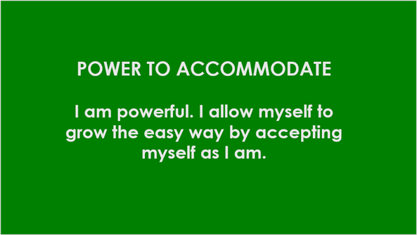

Slide 62
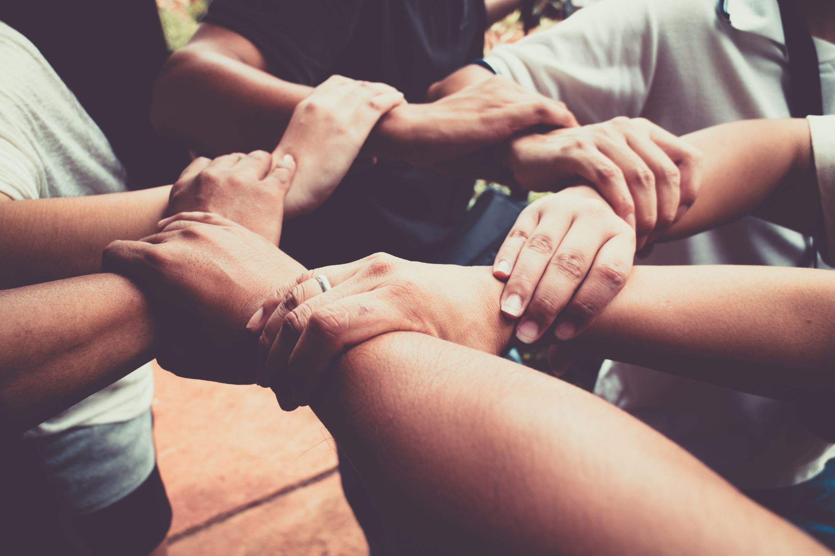
The Power to Cooperate
Willingness and capacity to see what is needed and provide it spiritually
Serve and surrender to the common good
Be an ally to others

Slide 63
POWER TO COOPERATE
I am powerful. I know when to
listen and when to speak, when
to lead and when to follow,
creating a dance of harmony.

Slide 64
POWER TO COOPERATE
I am powerful. Knowing that
receiving is as important as
giving, I let people help me and
show they care.

Slide 65
POWER TO COOPERATE
I am powerful. I offer my finger
of support to lift the mountain of
difficulties and make everything easy.

Slide 66
POWER TO COOPERATE
I am powerful. My talents flow
like cool waters on hot, dry land
and quench any thirst, quietly
and unconditionally.

Slide 67
POWER TO COOPERATE
I am powerful. I lend a hand and then move on, in dignity, never owning the helping.

Slide 68
